Slide 1



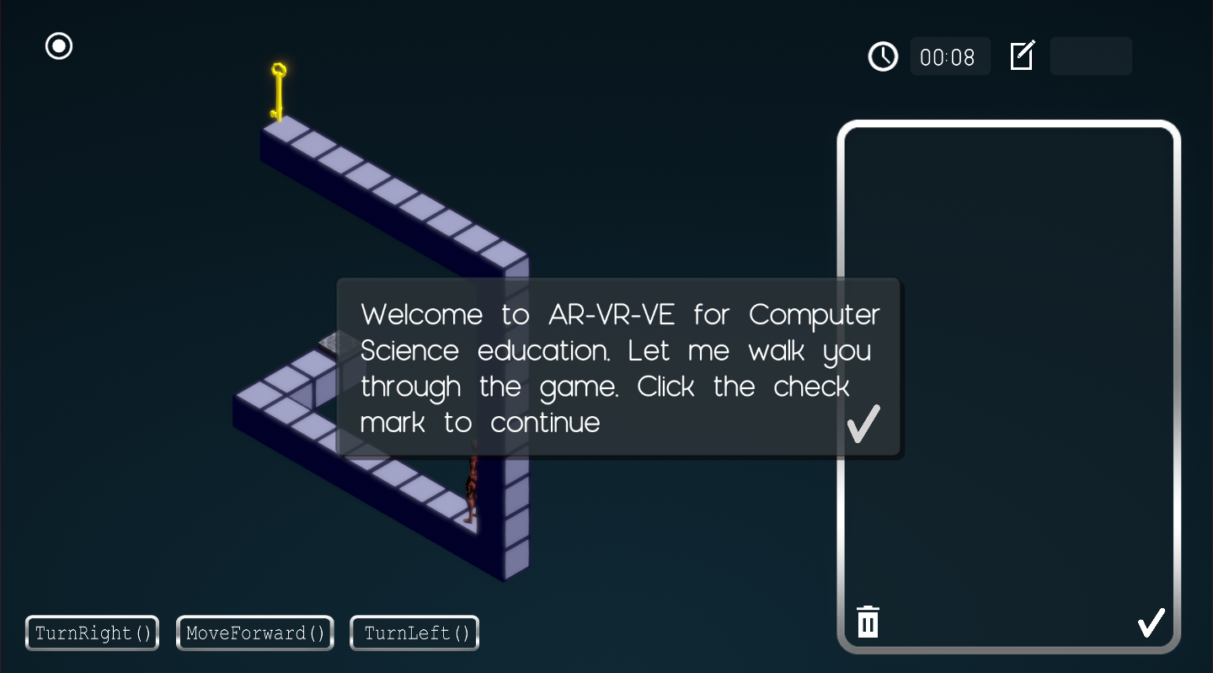
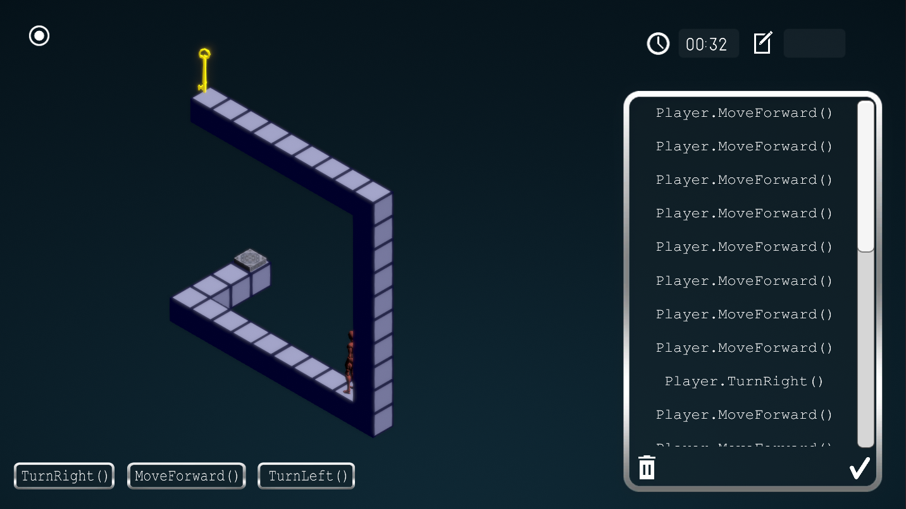
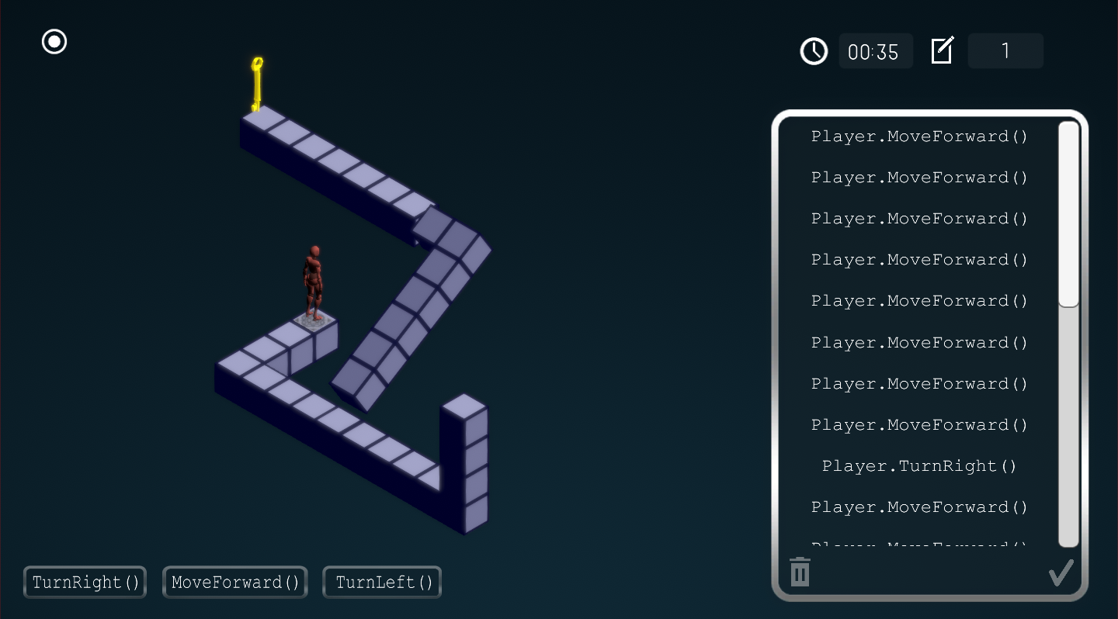
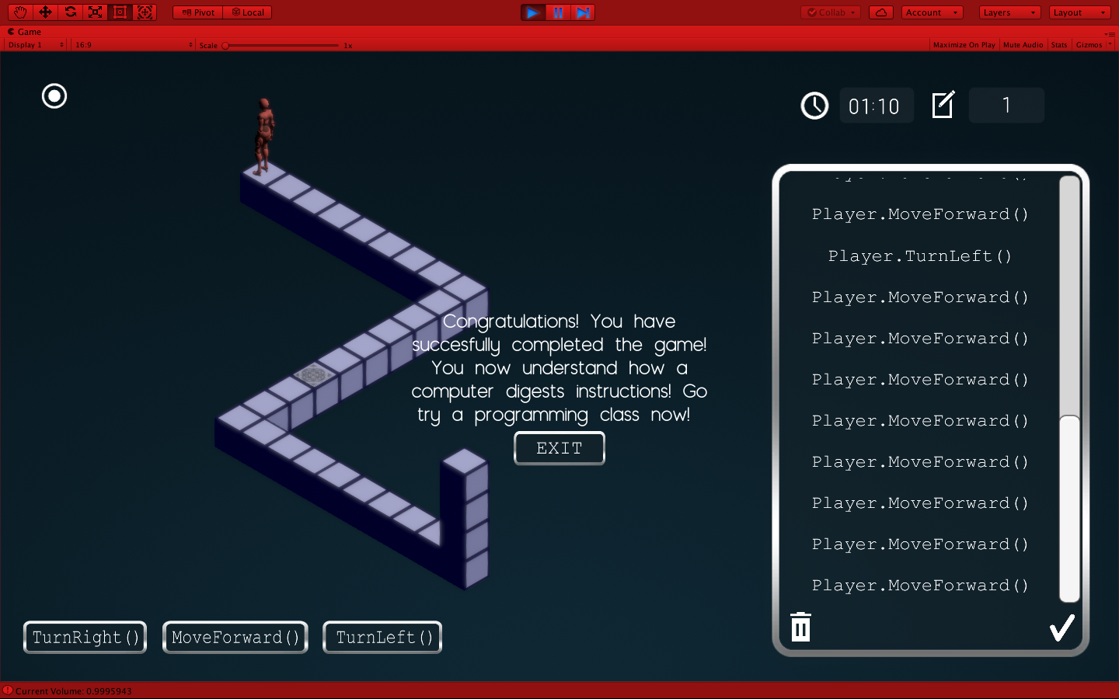
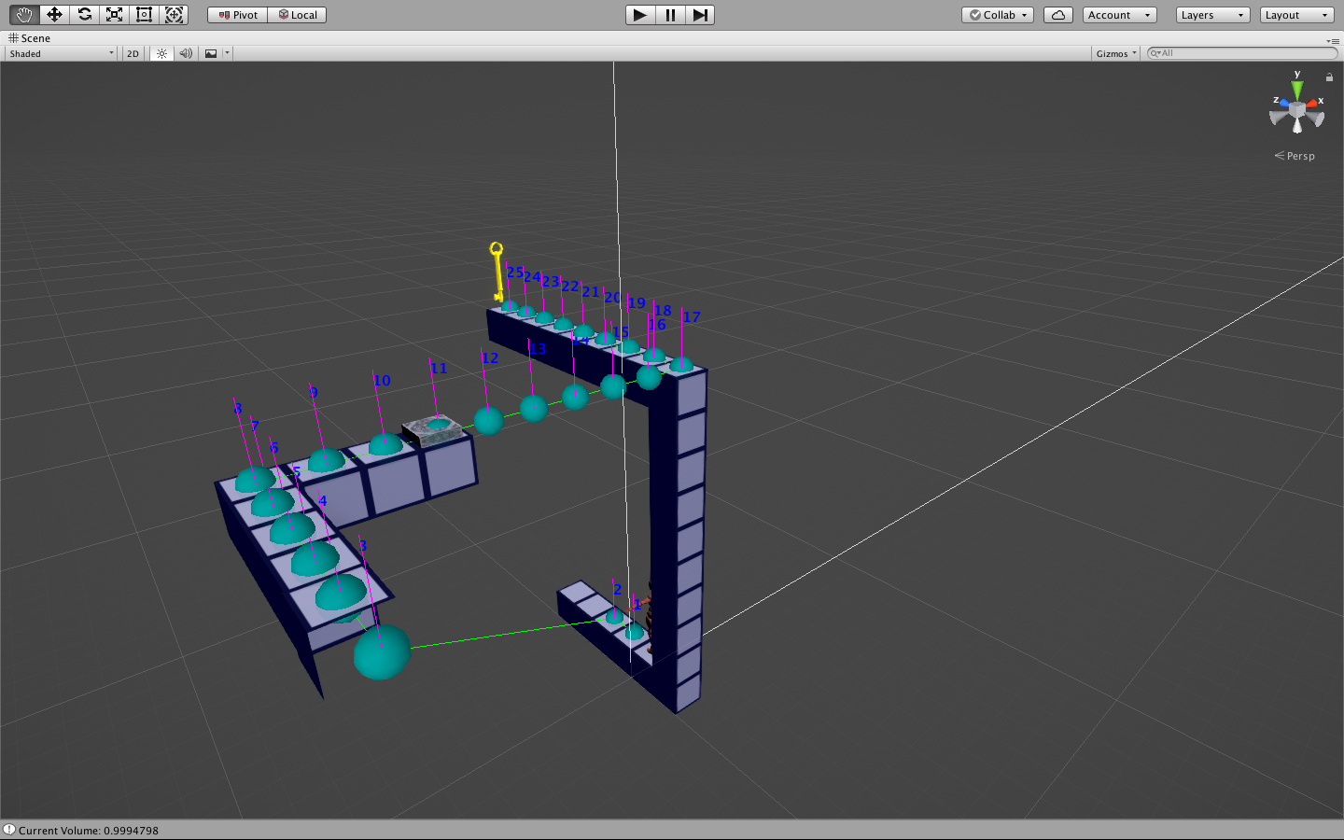
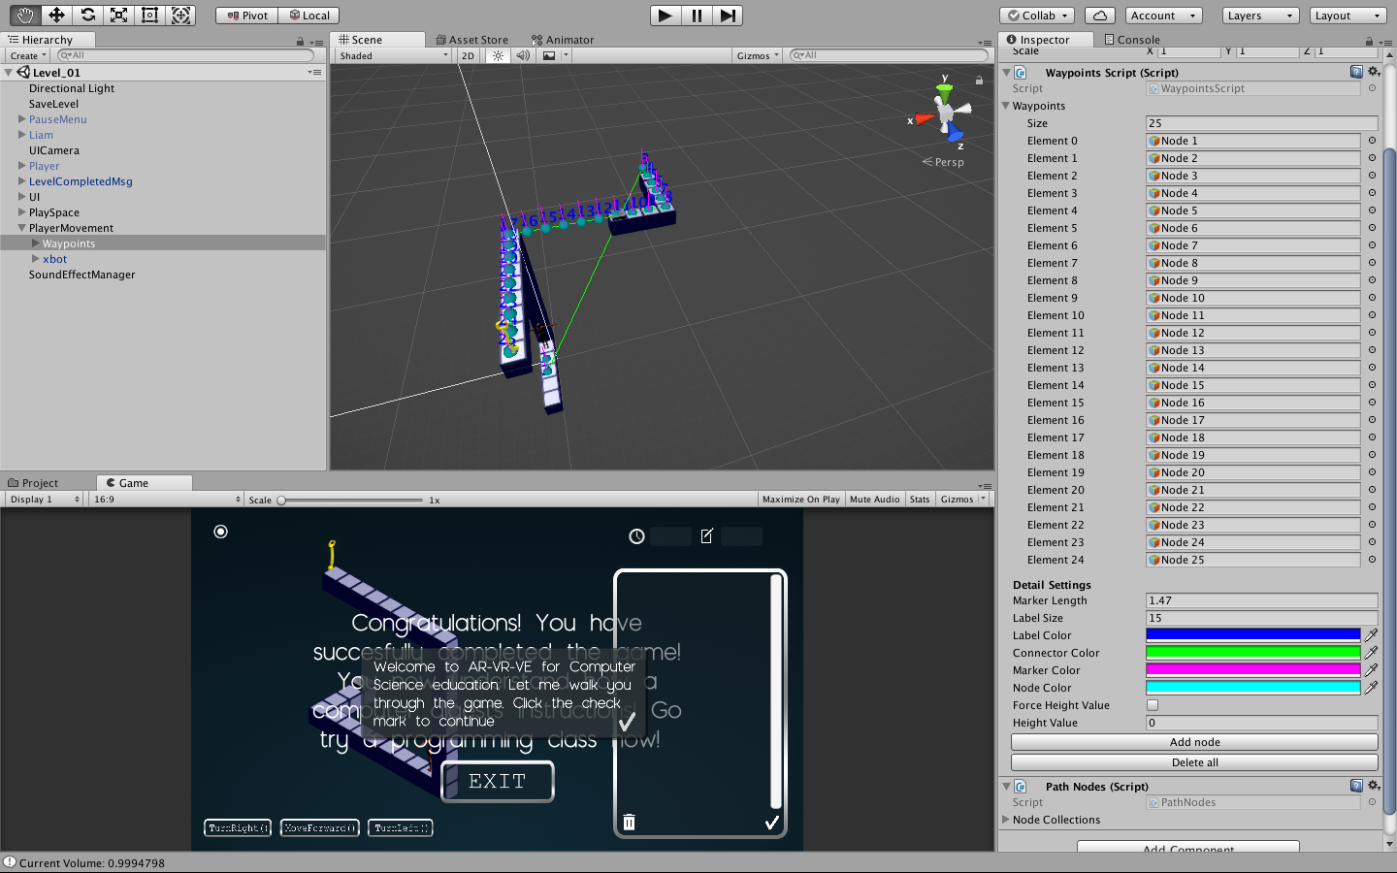






VIP IDS3917 2018, Spring
AR-VR-VE For Computer Science : A Desktop Game
Student: Arelys Alvarez, Florida International University
Mentor: Dr. Francisco R. Ortega, School of Computing & Information Science
Professor: Dr. Francisco R. Ortega & Masoud Sadjadi, Florida International University
Problem
There is a diversity problem in Computer Science.
Less than 18% of women are graduating from CS majors.
Students don’t choose careers in Computer Science because of the popular believe that these careers are less accessible.
Solution
Developed a user friendly game with the purpose of teaching basic programming concepts.
Make levels attractive, challenging and easy to understand.
Implement an engaging game to demonstrate that everyone can learn how to code.
Current System
VR Version, not so widely accessible.
Involves attempting to free a robot in a jail cell.
Screenshots
Requirements
Create a waypoints system to make the character navigate through the maze.
Implement a waypoint tool to add waypoints automatically.
Animate the character according to the movement.
Design mazes that are easy for the user to understand.
Modify the graphics and aesthetics to make sure it goes with the feeling of the game.
Use neutral colors and contrast them to give the environment of the game a neutral look.
System Design and Implementation
OS: Windows and Mac
Implementation Front/Backend: Unity 3D, C#
Version Control : Git
Graphic Design: Photoshop
Verification
Guarantee that the character don’t move if it is not in the correct position.
Guarantee that the character don’t move out of the maze.
Make sure the animation is synchronized with the movement of the character.
Try different colors to see which one is better to use.
Ensure that when the maze moves the 3D illusion is kept.
Guarantee that the size and the colors of the maze does not change when part of it moves.
Future Work
Implement more challenging levels.
Introduce OOP concepts.
Create more complex mazes.
Summary
With the development of this game we will contribute to reduce the diversity problem currently existing in Computer Science majors and Technology majors.
Acknowledgement
The material presented in this poster is based upon the work supported by Samira Tellez, Fidel Hernandez, Mairim Barrios and Carlos Martinez. I am thankful to the help that I received from my group members.
Notes:
1

